Slide 1

M&A Business Case Insert target company
Confidential
Author: insert your own text
Project Sponsor: insert your own text
Project Manager: insert your own text
Change Manager: insert your own text
Date: insert your own text
Version No: insert your own text
Status: E.g. 1.0 for final / 0.1 for drafts
Replace our logo by your own logo

Slide 2






This deliverable will focus on the third phase of our Mergers & Acquisitions 6-phase approach
I. Define your M&A Strategy
II. Identify Target Companies
III. Build a Business Case and an M&A Financial Model
IV. Conduct Due Diligence
V. Execute Transaction
VI. Conduct the Post Merger Integration
Company mission, vision and values
M&A strategic objectives and key performance indicators
M&A team
M&A guiding principles
Target screening criteria
Potential target companies and data collection
High-level assessment of potential target companies
Shortlisted potential targets
Financial statements analysis
Valuation: DCF model, comparable company analysis, and precedent transaction analysis
Targets approved for the business case phase
Strategic benefit
Feasibility
Financial benefit
Comprehensive M&A financial model including acquirer model, target model, merger assumptions & analysis, and pro forma model
Simple Financial model including integration cost, revenue synergy, cost synergy, NPV, ROI, and IRR
Letter of intent or term sheet
Work plan including key business case hypotheses & assumptions
Due diligence to validate key hypotheses and assumptions
Updated business valuation
Recommendation to make (or not) a formal offer to acquire the target company
Deal structure
M&A negotiations
Signing and closing the M&A deal
Post merger integration strategy & high-level plan: Strategic objectives, integration management office, guiding principles, high-level plan, organizational structure, top management appointment, synergies, integration & synergy initiatives, business cases and financial models
Post merger integration detailed plans: Detailed integration plan including the day 1 readiness checklist, integration & synergy initiatives plan, etc.
Implementation and monitoring

Slide 3
Guide
You can use this deliverable directly for your own purposes. You simply need to insert your logo and adjust the slides based on the specificities of your organization.
Please note that this document also includes many slides with best practices, tutorials and real-life examples to help you adjust this deliverable based on the specificities of your organization. These slides have an orange rectangle in the top-right corner. You may decide to delete these slides as they are mainly there to help you fill in the rest of the deliverable. Before you do, copy and paste this document so you always have the original version in case you need it.

Slide 4
Document Audience
Name | Role | Required / Optional
John Doe | CEO | Required
Insert Name | Insert role | Insert Required or Optional
Insert Name | Insert role | Insert Required or Optional
Insert Name | Insert role | Insert Required or Optional
Insert Name | Insert role | Insert Required or Optional
Insert Name | Insert role | Insert Required or Optional
Insert Name | Insert role | Insert Required or Optional

Slide 5
Document Purpose
The purpose of this document is to provide enough information to answer the question “should we acquire the company [insert company name]”. To answer this question, we will use an M&A framework that includes 3 components:
Financial Benefit
Strategic
Benefit
Feasibility

Slide 6
Each component has an underlying question that we will have to answer to identify if it is a good strategic initiative to acquire company Y
Financial Benefit
What would be the financial benefit of the deal?
Strategic
Benefit
Feasibility
What would be the strategic benefit of the deal?
What would be the feasibility of the deal?

Slide 7
If the answer is “high” or “very high” to the 3 questions, then it means that acquiring company Y is a good strategic initiative
Financial Benefit
What would be the financial benefit of the deal?
Strategic
Benefit
Feasibility
What would be the strategic benefit of the deal?
What would be the feasibility of the deal?
Sweet spot

Slide 8
Let’s start by assessing the strategic benefit of the deal
Financial Benefit
What would be the financial benefit of the deal?
Strategic
Benefit
Feasibility
What would be the strategic benefit of the deal?
What would be the feasibility of the deal?

Slide 9
Strategic Benefit What would be the strategic benefit of the deal?
Caption:
Very Low
Low
Medium
High
Very High
Very High
Vision & Strategic objectives
Insert in this box in which way this deal will help us deliver on our long-term vision and strategic objectives
M&A Strategy versus organic growth strategy
Insert in this box in which way acquiring company Y is a better option than an organic growth strategy.
M&A Strategy versus strategic alliance
Insert in this box in which way acquiring company Y is a better option than a strategic alliance with company Y.

Slide 10
Strategic Benefit What would be the strategic benefit of the deal?
Caption:
Very Low
Low
Medium
High
Very High
Very High
Replace this rating by your own rating based on the sections below
Vision & Strategic objectives
Insert in this box in which way this deal will help us deliver on our long-term vision and strategic objectives
M&A Strategy versus organic growth strategy
Insert in this box in which way acquiring company Y is a better option than an organic growth strategy.
M&A Strategy versus strategic alliance
Insert in this box in which way acquiring company Y is a better option than a strategic alliance with company Y.

Slide 11
Let’s now assess the feasibility of the deal
Financial Benefit
What would be the financial benefit of the deal?
Strategic
Benefit
Feasibility
What would be the strategic benefit of the deal?
What would be the feasibility of the deal?

Slide 12
Feasibility What would be the feasibility of the deal?
High
Capital requirement
Answer in this box the following questions: What is the capital required to acquire company Y? Do we have enough capital to acquire company Y without hurting the stability of the company?
Legal requirement
Answer in this box the following questions: Can we legally purchase company Y? Are there any antitrust regulations?
Culture
Answer in this box the following question: Is there a difference between the 2 cultures that could make the acquisition unsuccessful?
Risks
Answer in this box the following question: Any other potential risks we should anticipate?
Caption:
Very Low
Low
Medium
High
Very High

Slide 13
Feasibility What would be the feasibility of the deal?
High
Replace this rating by your own rating based on the sections below
Capital requirement
Answer in this box the following questions: What is the capital required to acquire company Y? Do we have enough capital to acquire company Y without hurting the stability of the company?
Legal requirement
Answer in this box the following questions: Can we legally purchase company Y? Are there any antitrust regulations?
Culture
Answer in this box the following question: Is there a difference between the 2 cultures that could make the acquisition unsuccessful?
Risks
Answer in this box the following question: Any other potential risks we should anticipate?
Caption:
Very Low
Low
Medium
High
Very High

Slide 14
And finally, let’s assess the financial benefit of the deal
Financial Benefit
What would be the financial benefit of the deal?
Strategic
Benefit
Feasibility
What would be the strategic benefit of the deal?
What would be the feasibility of the deal?

Slide 15
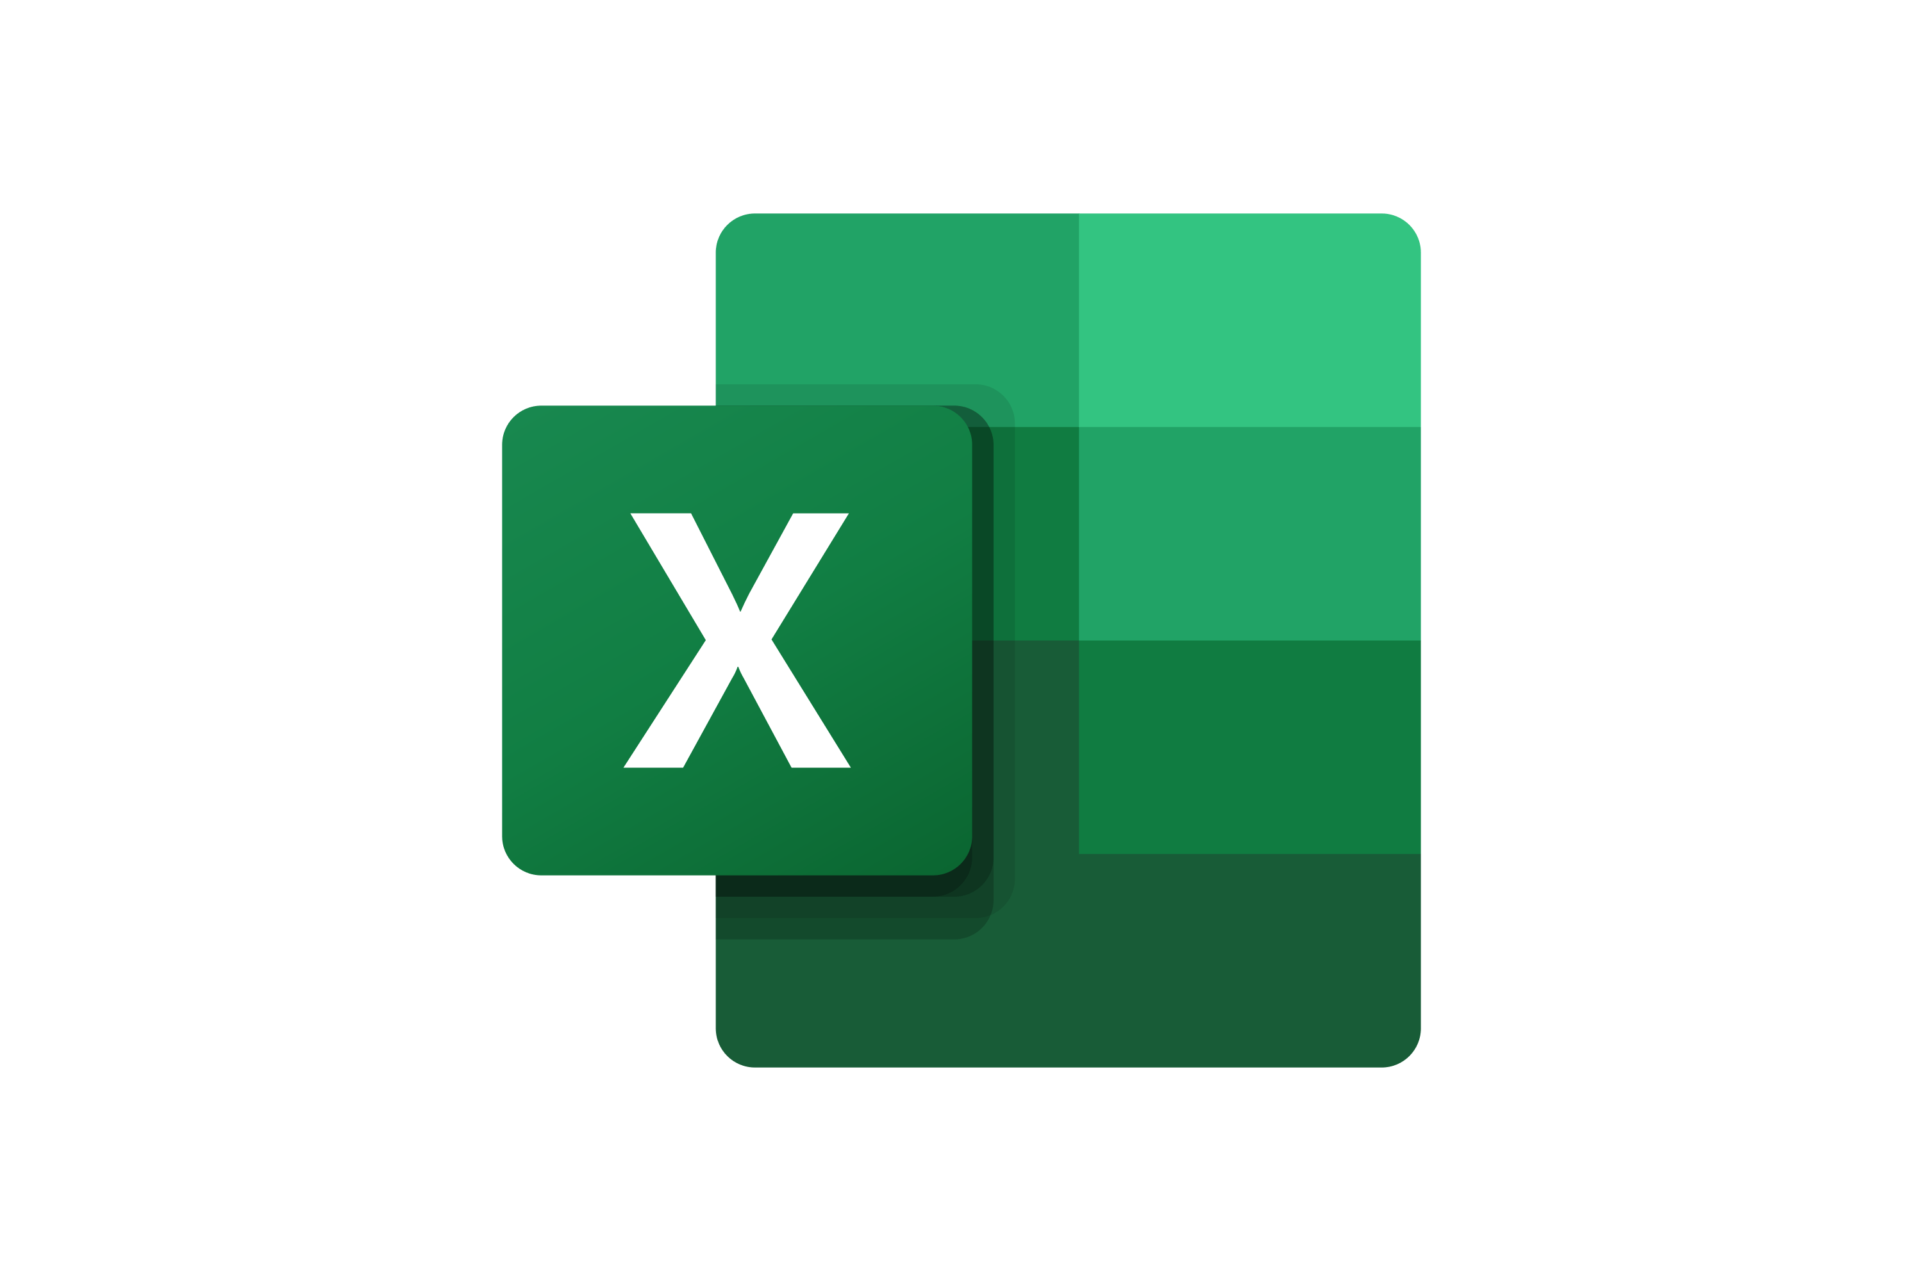
Financial Benefit We believe we could reasonably achieve $140M [insert your own number] of synergies by acquiring company [insert company name]
Total synergies over the next 2 years ($M)
For more details, open the Excel sheet “Mergers and Acquisitions Financial Model”

Slide 16
Financial Benefit We believe we could reasonably achieve $140M [insert your own number] of synergies by acquiring company [insert company name]
Tutorial
How much revenue synergy will the 2 combined entities reach? For example, let’s say that the company X has a revenue of $40M and the company Y has a revenue of $30M. If each sales force cross sells each other’s products, the 2 combined entities may reach a revenue of $90M. The revenue synergy would then be $20M.
Total synergies over the next 2 years ($M)
How much cost synergy will the 2 combined entities reach? For example, let’s say that the company X spends $20M per year in IT Cost and the company Y spends $10M per year in IT Cost. By removing unnecessary legacy IT Systems and all the unnecessary duplications, the 2 combined entities may end up spending only $25M per year instead of $30M. The IT cost synergy would then be $5M.
For more details, open the Excel sheet “Mergers and Acquisitions Financial Model”

Slide 17
Financial Benefit We estimated the total cost of the deal to $100M
Initial transaction cost
Integration cost
Total cost of the deal
$100M
$10M
$110M
+
=
For more details, open the Excel sheet “Mergers and Acquisitions Financial Model”

Slide 18
Financial Benefit We estimated the total cost of the deal to $100M
Tutorial
How much will it cost to integrate both entities?
Initial transaction cost
Integration cost
Total cost of the deal
$100M
$10M
$110M
+
=
For more details, open the Excel sheet “Mergers and Acquisitions Financial Model”

Slide 19
Financial Benefit We estimated the Net Present Value of the deal to $50M [insert your own number] and the Internal Rate of Return to 30%[insert your own number]
For more details, open the Excel sheet “Mergers and Acquisitions Financial Model”

Slide 20
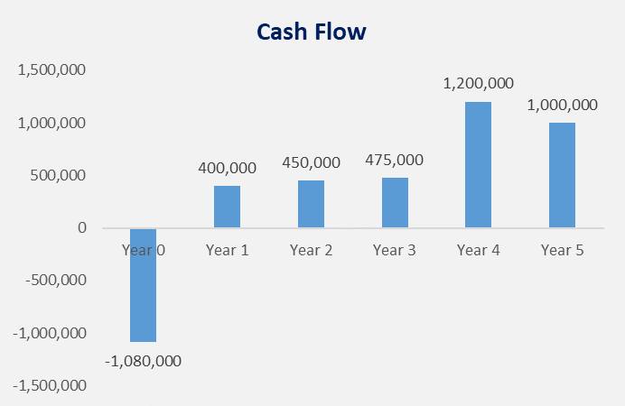
Financial Benefit Cash flow
For more details, open the Excel sheet “Mergers and Acquisitions Financial Model”

Slide 21
Financial Benefit Based on the previous slides, we believe that the financial benefit of the deal is “very high”
Financial Benefit
What would be the financial benefit of the deal?
Very High
Strategic
Benefit
Feasibility
What would be the strategic benefit of the deal?
What would be the feasibility of the deal?
Caption:
Very Low
Low
Medium
High
Very High

Slide 22
Financial Benefit Based on the previous slides, we believe that the financial benefit of the deal is “very high”
Tutorial
Replace this rating by your own rating based on the sections below
Financial Benefit
What would be the financial benefit of the deal?
Very High
Strategic
Benefit
Feasibility
Replace this rating by your own rating based on the sections below
What would be the strategic benefit of the deal?
What would be the feasibility of the deal?
Caption:
Very Low
Low
Medium
High
Very High

Slide 23
Conclusion and Recommendation We highly recommend to acquire company Y
Financial Benefit
What would be the financial benefit of the deal?
Very High
Strategic
Benefit
Feasibility
What would be the strategic benefit of the deal?
What would be the feasibility of the deal?
Very High
High
Caption:
Very Low
Low
Medium
High
Very High

Slide 24
Thanks for your attention!
www.domontconsulting.com

